Slide 1

Management of Acute Coronary Syndromes
Early Tx
PCI
Late Tx
Cases

Slide 2
Early Tx
Early ACS Management – NSTEMI and STEMI
PCI
Heparin / Enoxaparin
PCI planned → heparin
Medical management → enoxaparin
Late Tx
Cases
Gp IIb/IIIa inhibitor
(eptifibatide)
2nd line for angina, ↑ bleeding risk
Oxygen
SpO₂ <90%
O
O
A
A
H/E
H/E
Pain (N, B, G, M)
All ACS
Pain (N, B, M, G)
DC
0
90 min
2h
24h
48h
72h
Aspirin
325 mg chewed (or PR) then 81mg qday
Beta-blocker
PO>IV
(initiate <24h)
Avoid in ↓ BP, ↓ HR, cardiogenic shock
Nitroglycerin
0.4 mg tabs x 3 q5min or IV drip
Avoid if ↓ BP, PDE5i, R-sided MI, LVOT obstruction, severe AS
Morphine
2nd line after nitrates
(can mask refractory angina)

Slide 3
Early Tx
Re-vascularization
Emergent Revascularization
PCI
Emergent Revascularization
Late Tx
PCI Capable
PCI capable: PCI < 90 min
Yes
Cases
Non-PCI Capable
PCI Capable Hospital <120 min?
Non-PCI Capable
Non-PCI Capable
No
PCI hospital <120 min: Transfer, then PCI <120 min
STEMI
STEMI
Non-PCI hospital <120 min: Fibrinolytics <90 min
Transfer and PCI when able
All ACS
O
A
H/E
Pain (N, B, G, M)
DC
0
90 min
2h
24h
48h
72h
NSTEMI
Risk stratify using clinical presentation, or
Risk stratification?
GRACE score
TIMI score
NSTEMI
GRACE score
TIMI score
Immediate PCI
Urgent/Immediate PCI (<2 h)
Cardiogenic shock
Refractory Angina
Early PCI
(High risk)
GRACE >140 | TIMI > 6-7
New ST dep, ↑ trop
Delayed PCI
(Mod-Low risk)
GRACE 109-140 | TIMI > 3-5
Hemodynamic Instability
Electrical Instability (VT/VF)
High Risk
Ischemia Guided Strategy – Stress test + medical management
(Very low risk population)
GRACE <109 | TIMI 0-1
Mod-Low Risk
Very Low Risk

Slide 4
Early Tx
Late ACS Management – NSTEMI and STEMI
PCI
P₂Y₁₂ inhibitor
Initiate after PCI, ticagrelor is superior in STEMI
Avoid if anticipating CABG
Late Tx
ACE/ARB
(initiate before discharge)
STEMI – all patients
NSTEMI – LVEF <40% ± HTN, DM, CKD
Cases
Statin
(initiate <24h)
High dose, high intensity (atorvastatin, rosuvastatin)
STEMI
Emergent PCI
O
A
H/E
Pain (N, B, G, M)
S
S
B
B
P
P
A
A
M
All ACS
M
DC
0
90 min
2h
24h
48h
72h
NSTEMI
Urgent/Immediate PCI
Early PCI
Delayed PCI
Beta-blocker
(initiate <24h)
Avoid in ↓ BP, ↓ HR, cardiogenic shock
MRA
(initiate before discharge)
LVEF <40%, HF, DM and tolerating other meds

Slide 5
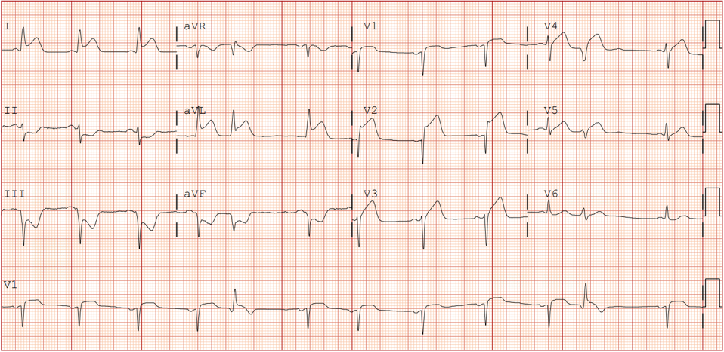
Early Tx
Case 1
PCI
61-year-old with PMHx of hypertension, diabetes and hyperlipidemia presents with chest pain. Vitals show T 36.4C, HR 114, BP 105/78, SaO2 94%.
Late Tx
Cases
When should this patient undergo revascularization (if at all)?
1
EMERGENTLY! This ECG shows ST elevations in I, aVL, V1-V4 consistent with an LAD STEMI. At PCI capable hospital, the cath lab should be activated and PCI performed <90 min.
2
3
Courtesy of Benjamin Titus, MD.
What if the patient was at a non-PCI capable hospital?
What medical therapy would you initiate while awaiting PCI?
They undergo PCI with DES to LAD. HR 80, BP 135/90. TTE shows EF of 50%. Labs show Cr 0.9, K 4.0
Transfer to PCI-capable hospital if estimated door-to-balloon time is still <120 min.
If not, treat with fibrinolytics <90 min → transfer for delayed PCI <24 hours. Consider individual bleeding risk.
Aspirin 325 mg chewed (or PR)
Heparin drip given planned PCI
Hold on P₂Y₁₂ inhibitor in the event of needing a CABG
PO beta-blocker (e.g., metoprolol) for angina
PRN nitrates or morphine
What medical therapy would you initiate prior to discharge?
Aspirin + ticagrelor (superior P₂Y₁₂ inhibitor in STEMI)
High intensity statin (e.g., rosuvastatin 20 mg)
Beta-blocker
ACE/ARB (for all STEMI)
No indication for MRA (LVEF>40%)

Slide 6
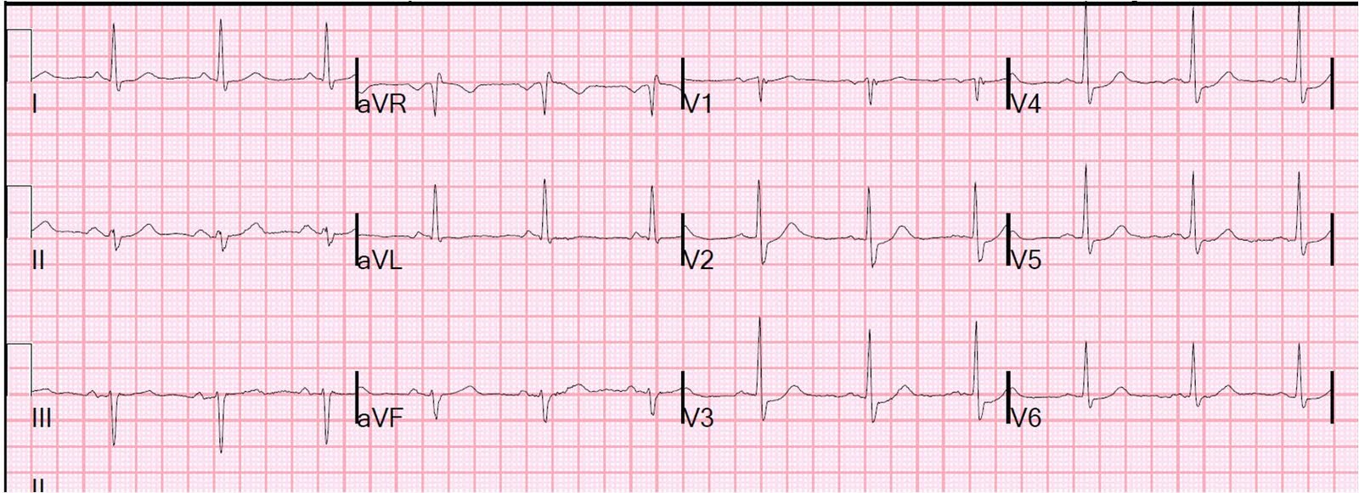
Early Tx
Case 2
PCI
45-year-old with DM type II presents with crushing substernal chest pain. Vitals show HR is 110, BP 82/45, SaO2 82% on room air.
Late Tx
Cases
How would you manage pain?
1
May consider GPIIb/IIIa inhibitor (eptifibatide). Nitrates, morphine and beta-blockers are contraindicated with hypotension.
2
3
Courtesy of Stephen Smith, MD. Dr. Smith’s ECG blog. CC BY-NC 4.0
When should this patient undergo revascularization (if at all?)
What medical therapy would you initiate while awaiting PCI?
They undergo PCI with DES to proximal LAD. VS are now HR 80, BP 135/90. TTE shows EF of 28%. Labs show Cr 0.9, K 4.0
Immediate/ urgent (<120 min). This is an NSTEMI (ST depressions V2-V4) but has high-risk features (cardiogenic shock, refractory angina since most anti-anginals are contraindicated).
Other high-risk features that would prompt immediate PCI include ventricular arrhythmias, persistent angina
Oxygen (hypoxic on room air)
Aspirin 325 mg chewed (or PR)
Heparin drip given planned PCI
Hold on P2Y12 inhibitor in the event of needing a CABG
High intensity statin
What medical therapy would you initiate prior to discharge?
Dual antiplatelet (e.g., aspirin + clopidogrel)
Beta-blocker when euvolemic and no longer decompensated
ACE/ARB (given DM and EF<40%)
MRA (given DM and EF<40%)

Slide 7
Early Tx
Case 3
PCI
41-year-old with PMHx of anxiety with one episode of chest pain. Vital signs show HR 85, BP 145/85, SaO2 94% on room air.
ECG: T-wave inversions in precordial leads.
Labs: hs-troponin I is 25 ng/L → 110 ng/L (H) → 15 ng/L.
While awaiting stress test, what therapy would you initiate?
Late Tx
Aspirin
Lovenox (superior to heparin in medical management)
High intensity statin
Beta blocker
Nitro PRN chest pain
P₂Y₁₂ inhibitor can be held prior to knowing coronary anatomy
Cases
1
What is your diagnosis?
2
NSTEMI. This meets criteria with elevated troponin + chest pain + ECG change.
A treadmill stress test (TTE) showed inducible wall motion abnormalities concerning for ischemia. TTE showed LVEF of 45%.
3
How would you estimate their mortality risk?
What is your next step in management?
Very low risk. GRACE and TIMI score can be used to risk stratify patients with NSTEMI.
GRACE score is 53 → 0.8% probability of death in 6 months. TIMI score is 1 → 5% all cause mortality at 14 days.
PCI followed by medical management of NSTEMI.
What revascularization strategy would you choose?
Very low risk patients can be managed with an ischemia guided strategy. This includes a stress test and medical management, especially considered when patient preference.

Slide 8
2025 ACC/AHA ACS Guideline — What Changed Since This Talk (Oct 2023)
Antiplatelet therapy
• Ticagrelor OR prasugrel preferred over clopidogrel in STEMI & NSTE-ACS undergoing PCI (Class 1); clopidogrel if contraindicated/unavailable.
• DAPT ≥12 mo default if not high bleeding risk. To cut bleeding: PPI if GI-bleed risk; ticagrelor monotherapy ≥1 mo post-PCI if DAPT tolerated; if long-term OAC needed, stop aspirin 1–4 wk post-PCI, continue P2Y12 (pref. clopidogrel).
Lipids
• High-intensity statin for ALL ACS, option of concurrent ezetimibe. Add nonstatin (ezetimibe, PCSK9 mAb, inclisiran, bempedoic acid) if LDL-C ≥70 mg/dL on max statin; intensifying reasonable if LDL-C 55–<70.
Revascularization & procedure
• NSTE-ACS intermediate/high risk: invasive approach during hospitalization. Low risk: routine invasive OR selective invasive.
• Radial access preferred over femoral (↓bleeding, ↓mortality); intravascular imaging for complex lesions (Class 1).
• Complete revascularization recommended in STEMI & NSTE-ACS; in cardiogenic shock, culprit-only PCI (no routine non-IRA PCI at same sitting); microaxial flow pump reasonable in select AMI-CS.
Other
• Transfusion to Hgb 10 g/dL may be reasonable in ACS with anemia (not actively bleeding). Lipid panel 4–8 wk after starting/changing therapy; refer to cardiac rehab.
Source: Rao SV et al. 2025 ACC/AHA/ACEP/NAEMSP/SCAI ACS Guideline. Circulation 2025;151. doi:10.1161/CIR.0000000000001309

Slide 9
Take-Home Points
• STEMI → emergent reperfusion: PCI <90 min if PCI-capable; transfer if door-to-balloon <120 min achievable; otherwise fibrinolytics <90 min then transfer for angiography (3–24 h).
• NSTEMI → risk stratify (GRACE/TIMI + clinical features): very high risk → immediate PCI (<2 h); high risk → early invasive (<24 h); mod-low → delayed invasive (25–72 h); very low risk → ischemia-guided strategy possible.
• Early meds for all ACS (no contraindications): aspirin 325 mg chewed, anticoagulation (heparin if PCI planned; enoxaparin if medical mgmt), nitrates, beta-blocker <24 h — never delay emergent revascularization for them.
• Within 24 h: high-intensity statin + P2Y12 inhibitor (post-PCI). Before discharge: ACEi/ARB (all STEMI; NSTEMI w/ EF<40%, HTN, DM, or CKD) and MRA (EF<40%, HF, or DM, if tolerating BB + ACEi/ARB).
• Avoid routine O2 if SpO2 ≥90%; morphine is last-line (masks refractory angina). Ongoing chest pain on max therapy = ongoing ischemia → revascularize.

Slide 10
Attribution & Changelog
Original
• "Management of Acute Coronary Syndrome" — Coffer Thielen S, Slaven S, Burke J; eds. Zhang Y, Fainstad B. TeachIM.org, Oct 2023. https://teachim.org/teaching_material/acs/ — CC BY-NC 4.0. Educational use only; not medical advice.
Corrections made to this copy (June 2026)
• Slide 2: oxygen indication "SpO2 >90%" → "SpO2 <90%" (per lesson handout table & 2025 guideline).
• Slide 7 (Case 3): hs-troponin units "μg/dL" → "ng/L" (3 instances).
Appended (originals untouched)
• 2025 ACC/AHA ACS guideline update slide; take-home points slide; this attribution slide. All animations and click-to-reveal builds preserved.
Companion files
• None — the lesson page’s handout links mislink to Alcohol-related Liver Disease files; no ACS-specific handouts were available. Full optimized package: ACS_Management_Lesson_Package.html.

